Slide 1
Object and Class Structuring

Slide 2
Objectives
Provide guidelines on how to determine the classes/objects in the system
Define class/object structuring criteria

Slide 3
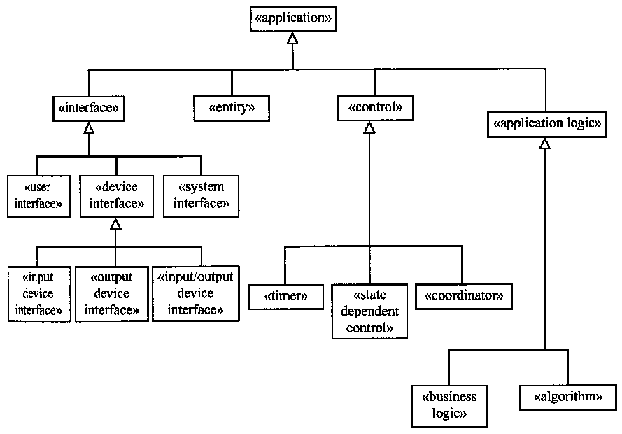
Categorization of Application Classes

Slide 4
External Classes and Interface Classes
External classes are classes that are external to the system and that interface to the system.
Interface (boundary) classes are classes internal to the system that interface to the external classes.

Slide 5
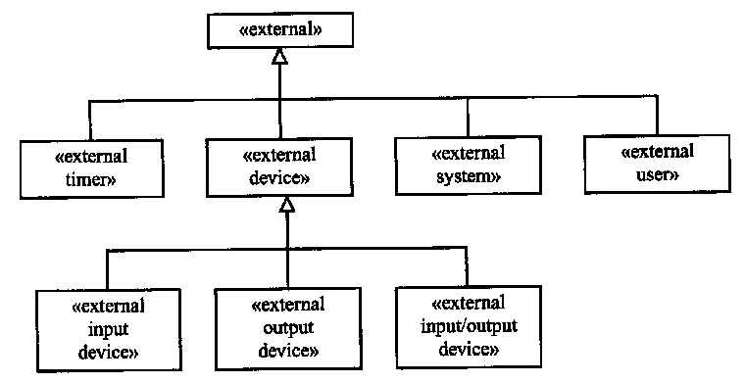
Categorization of External Classes

Slide 6
Identifying Interface Classes
Each of the external classes interfaces to an interface class in the system.
  An external user class interfaces to a user interface class
  An external system class interfaces to a system interface class
  An external input device class interfaces to an input device interface class
  An external output device class interfaces to an output device interface class
  An external I/O device class interfaces to an I/O device interface class
  An external timer class interfaces to an internal timer class

Slide 7
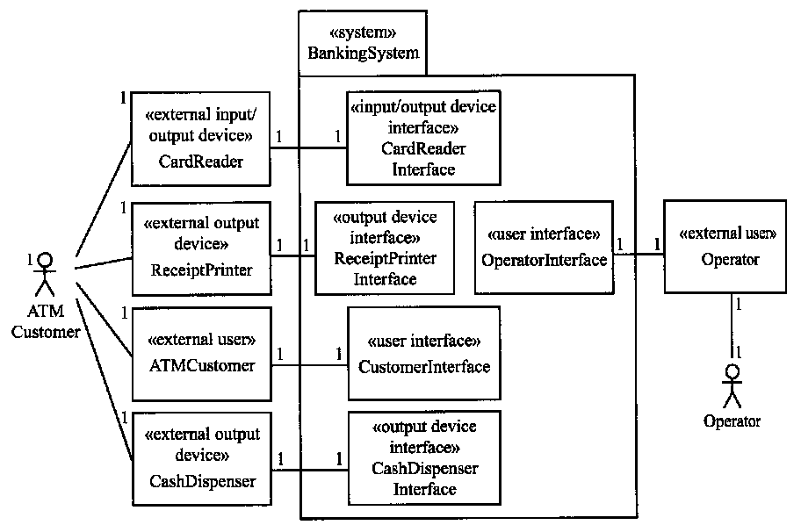
Banking System: External Classes and Interface Classes

Slide 8
Entity Classes
Store information
Often mapped to relational database during design

Slide 9
Control Classes
A control class provides the overall coordination for execution of a use case.
Makes overall decision
Control objects decides when, and in what order, other objects participate in use case
  Interface objects
  Entity objects
Simple use cases do not need control objects.

Slide 10
Kinds of Control Classes
Coordinator class
  Provides sequencing for use case
  Is not state dependent
State dependent control class
  Defined by finite state machine
Timer class
  Activated periodically

Slide 11
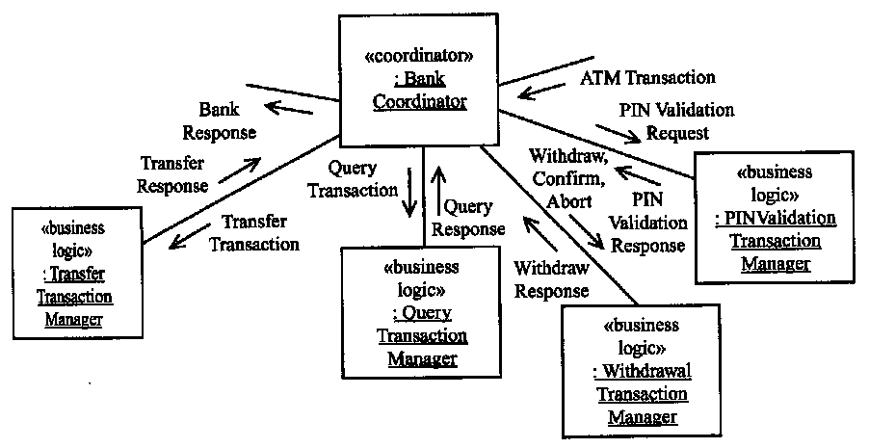
Example: Coordinator Object

Slide 12
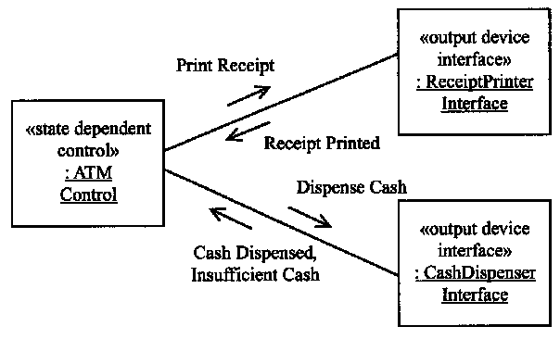
Example: State Dependent
Control Object

Slide 13
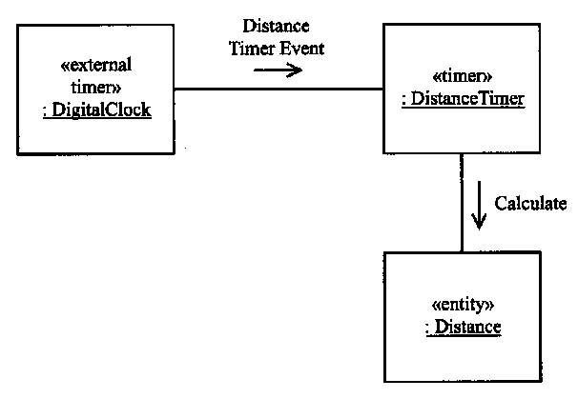
Example: Timer Object

Slide 14
Application Logic Classes
Business logic class
  Defines business-specific application logic (rules) for processing a client request
  Usually accesses more that one entity object
Algorithm class
  Encapsulates algorithm used in problem domain
  More usual in scientific, engineering, real-time domains

Slide 15
Example: Business Logic Object

Slide 16
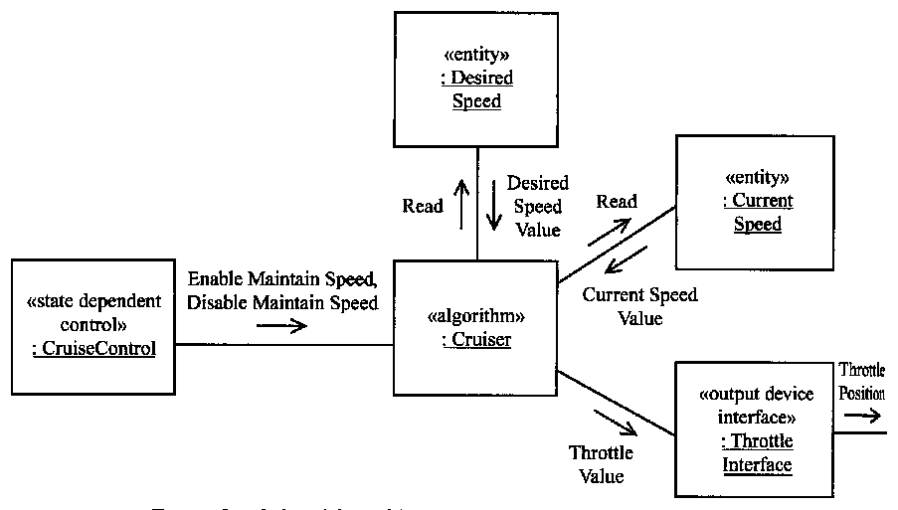
Example: Algorithm Object

